Slide 1
Chapter 3: Describing Relationships
Section 3.2
Least-Squares Regression
The Practice of Statistics, 4th edition – For AP*
STARNES, YATES, MOORE

Slide 2
Chapter 3 Describing Relationships
3.1 Scatterplots and Correlation
3.2 Least-Squares Regression

Slide 3
Section 3.2 Least-Squares Regression
Learning Objectives
After this section, you should be able to…
INTERPRET a regression line
CALCULATE the equation of the least-squares regression line
CALCULATE residuals
CONSTRUCT and INTERPRET residual plots
DETERMINE how well a line fits observed data
INTERPRET computer regression output

Slide 4
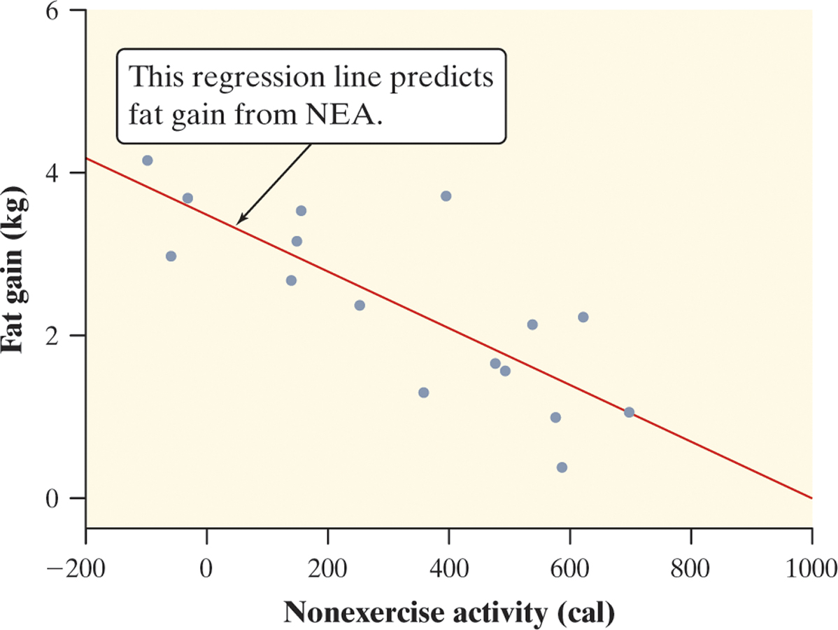
Least-Squares Regression
Regression Line
Linear (straight-line) relationships between two quantitative variables are common and easy to understand. A regression line summarizes the relationship between two variables, but only in settings where one of the variables helps explain or predict the other.
Definition:
A regression line is a line that describes how a response variable y changes as an explanatory variable x changes. We often use a regression line to predict the value of y for a given value of x.
Figure 3.7 on page 165 is a scatterplot of the change in nonexercise activity (cal) and measured fat gain (kg) after 8 weeks for 16 healthy young adults.
The plot shows a moderately strong, negative, linear association between NEA change and fat gain with no outliers.
The regression line predicts fat gain from change in NEA.
When nonexercise activity = 800 cal, our line predicts a fat gain of about 0.8 kg after 8 weeks.

Slide 5
Least-Squares Regression
Interpreting a Regression Line
A regression line is a model for the data, much like density curves. The equation of a regression line gives a compact mathematical description of what this model tells us about the relationship between the response variable y and the explanatory variable x.
Definition:
Suppose that y is a response variable (plotted on the vertical axis) and x is an explanatory variable (plotted on the horizontal axis). A regression line relating y to x has an equation of the form
ŷ = a + bx
In this equation,
ŷ (read “y hat”) is the predicted value of the response variable y for a given value of the explanatory variable x.
b is the slope, the amount by which y is predicted to change when x increases by one unit.
a is the y intercept, the predicted value of y when x = 0.

Slide 6
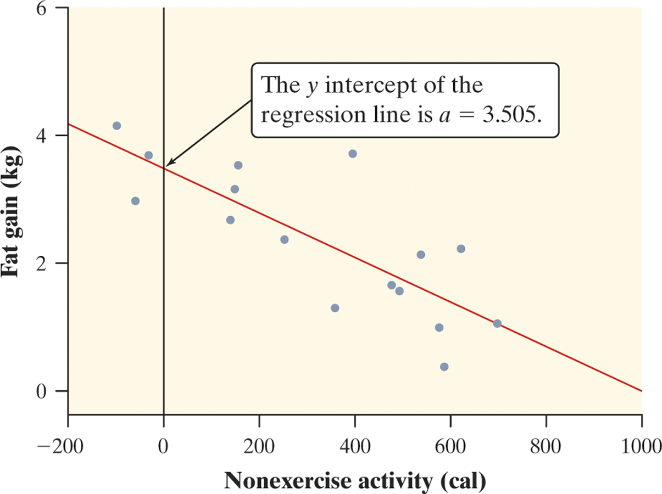
Least-Squares Regression
Interpreting a Regression Line
Consider the regression line from the example “Does Fidgeting Keep You Slim?” Identify the slope and y-intercept and interpret each value in context.
The slope b = -0.00344 tells us that the amount of fat gained is predicted to go down by 0.00344 kg for each added calorie of NEA.
The y-intercept a = 3.505 kg is the fat gain estimated by this model if NEA does not change when a person overeats.

Slide 7
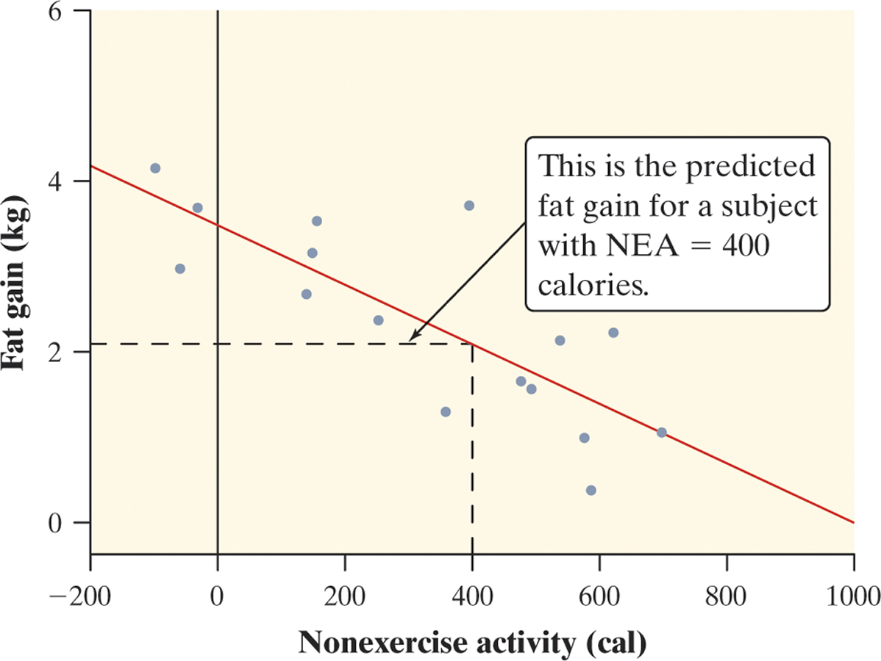
Least-Squares Regression
Prediction
We can use a regression line to predict the response ŷ for a specific value of the explanatory variable x.
Use the NEA and fat gain regression line to predict the fat gain for a person whose NEA increases by 400 cal when she overeats.
We predict a fat gain of 2.13 kg when a person with NEA = 400 calories.

Slide 8
Least-Squares Regression
Extrapolation
We can use a regression line to predict the response ŷ for a specific value of the explanatory variable x. The accuracy of the prediction depends on how much the data scatter about the line.
While we can substitute any value of x into the equation of the regression line, we must exercise caution in making predictions outside the observed values of x.
Definition:
Extrapolation is the use of a regression line for prediction far outside the interval of values of the explanatory variable x used to obtain the line. Such predictions are often not accurate.
Don’t make predictions using values of x that are much larger or much smaller than those that actually appear in your data.

Slide 9
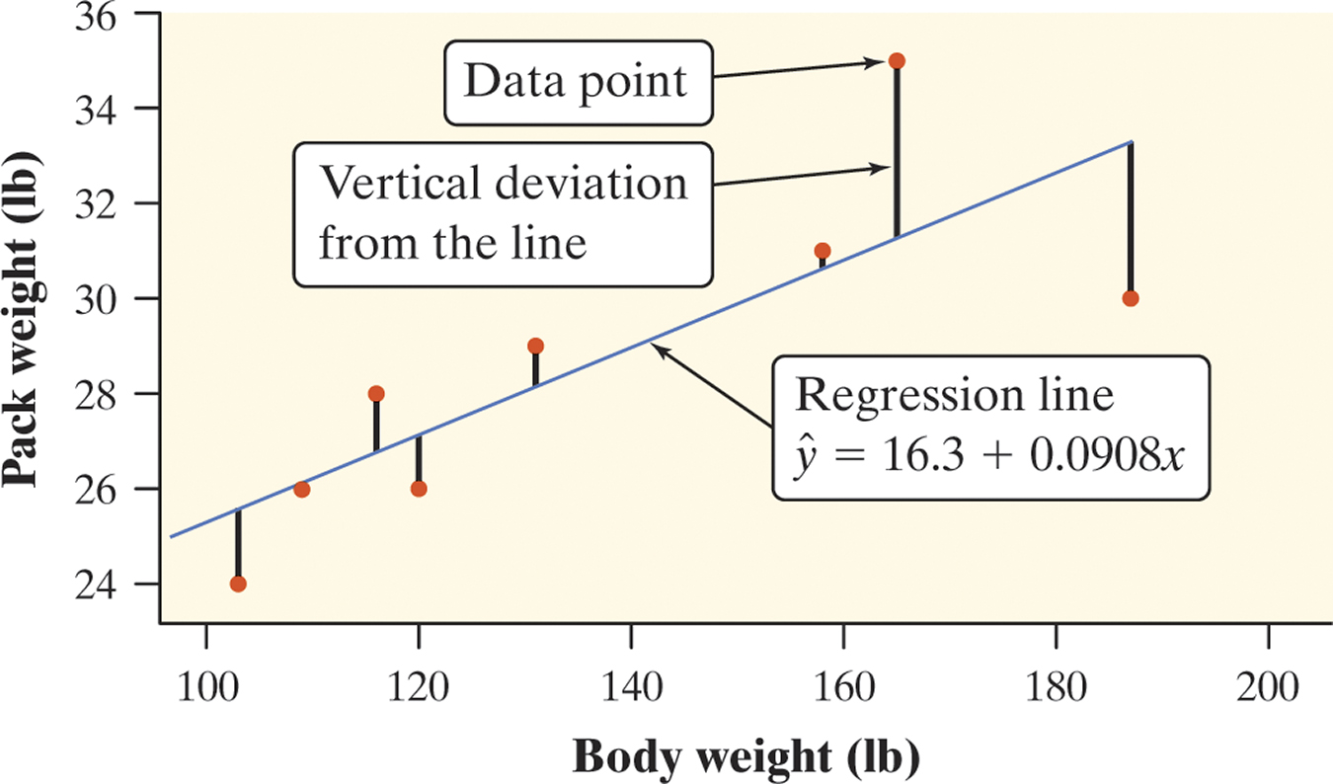
Least-Squares Regression
Residuals
In most cases, no line will pass exactly through all the points in a scatterplot. A good regression line makes the vertical distances of the points from the line as small as possible.
Definition:
A residual is the difference between an observed value of the response variable and the value predicted by the regression line. That is,
residual = observed y – predicted y
residual = y - ŷ
Positive residuals
(above line)
residual
Negative residuals
(below line)

Slide 10
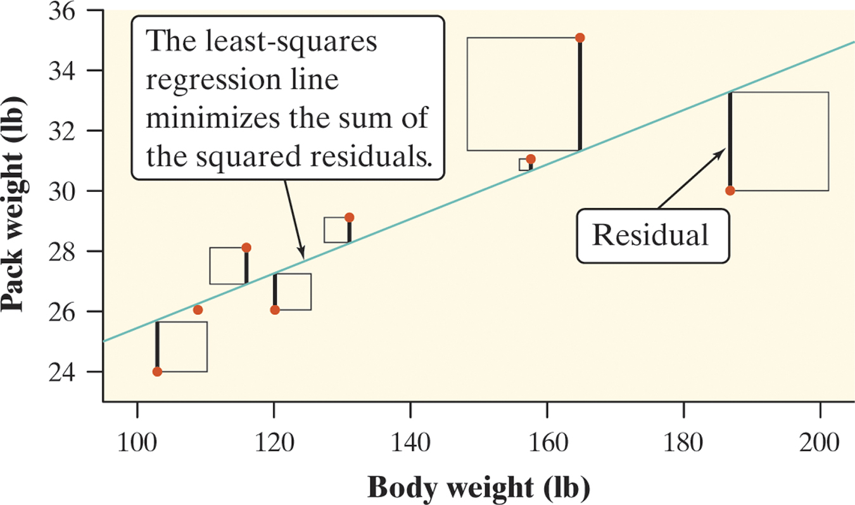
Least-Squares Regression
Least-Squares Regression Line
Different regression lines produce different residuals. The regression line we want is the one that minimizes the sum of the squared residuals.
Definition:
The least-squares regression line of y on x is the line that makes the sum of the squared residuals as small as possible.

Slide 11
Least-Squares Regression
Least-Squares Regression Line
We can use technology to find the equation of the least-squares regression line. We can also write it in terms of the means and standard deviations of the two variables and their correlation.
Definition: Equation of the least-squares regression line
We have data on an explanatory variable x and a response variable y for n individuals. From the data, calculate the means and standard deviations of the two variables and their correlation. The least squares regression line is the line ŷ = a + bx with
slope
and y intercept

Slide 12
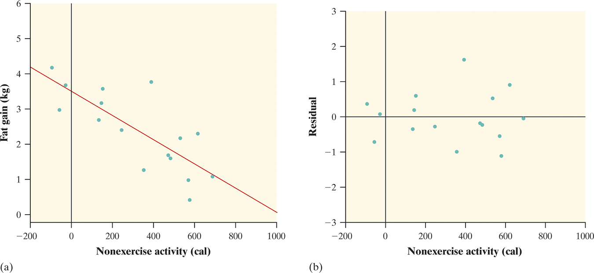
Least-Squares Regression
Residual Plots
One of the first principles of data analysis is to look for an overall pattern and for striking departures from the pattern. A regression line describes the overall pattern of a linear relationship between two variables. We see departures from this pattern by looking at the residuals.
Definition:
A residual plot is a scatterplot of the residuals against the explanatory variable. Residual plots help us assess how well a regression line fits the data.

Slide 13
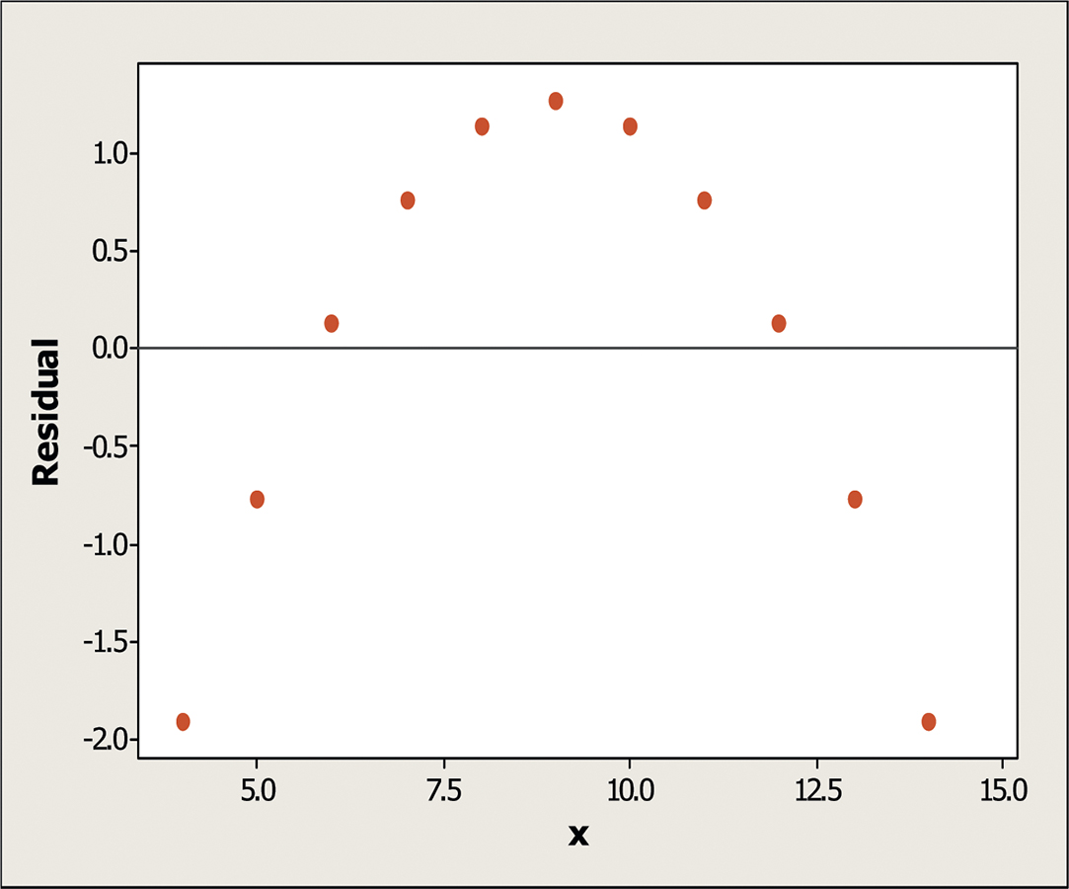
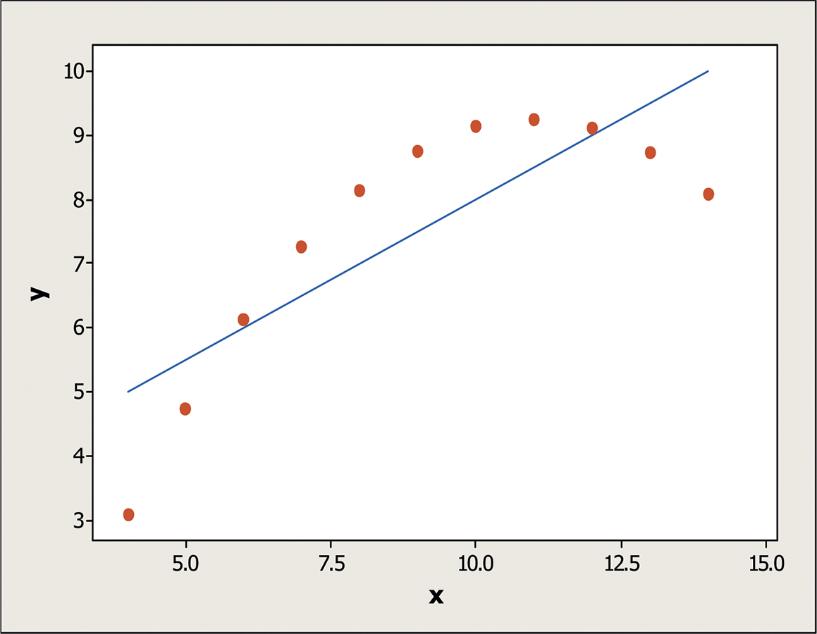
Least-Squares Regression
Interpreting Residual Plots
A residual plot magnifies the deviations of the points from the line, making it easier to see unusual observations and patterns.
The residual plot should show no obvious patterns
The residuals should be relatively small in size.
Pattern in residuals
Linear model not appropriate
Definition:
If we use a least-squares regression line to predict the values of a response variable y from an explanatory variable x, the standard deviation of the residuals (s) is given by

Slide 14
Least-Squares Regression
The Role of r² in Regression
The standard deviation of the residuals gives us a numerical estimate of the average size of our prediction errors. There is another numerical quantity that tells us how well the least-squares regression line predicts values of the response y.
Definition:
The coefficient of determination r² is the fraction of the variation in the values of y that is accounted for by the least-squares regression line of y on x. We can calculate r² using the following formula:
where
and

Slide 15
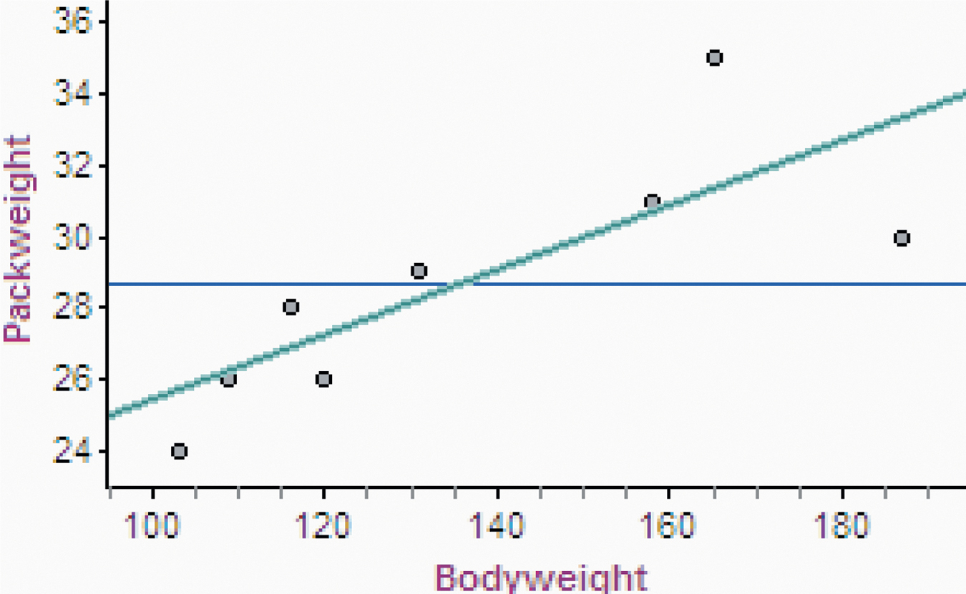
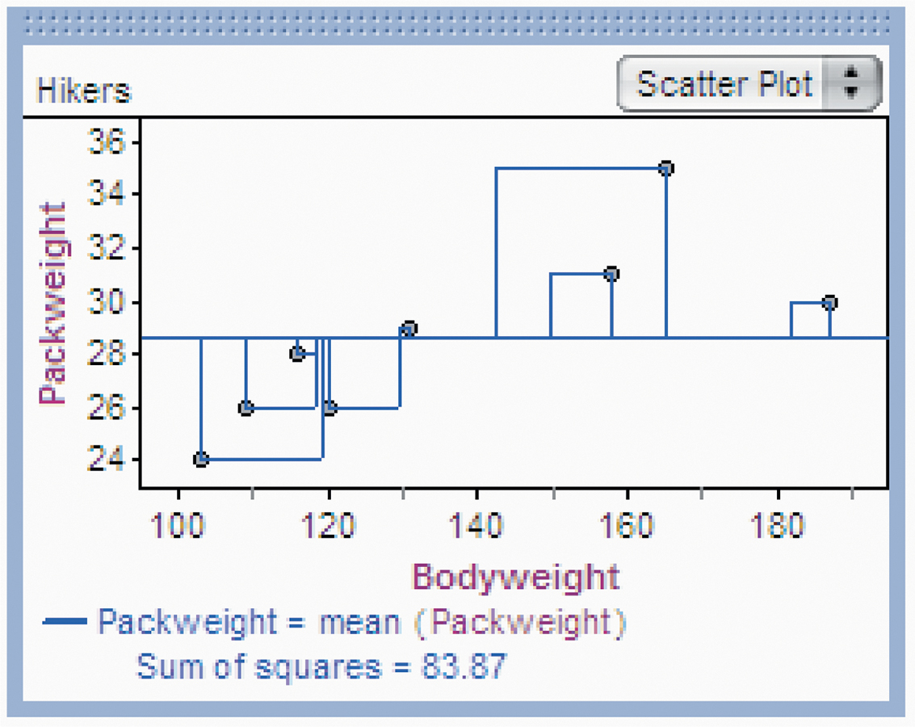
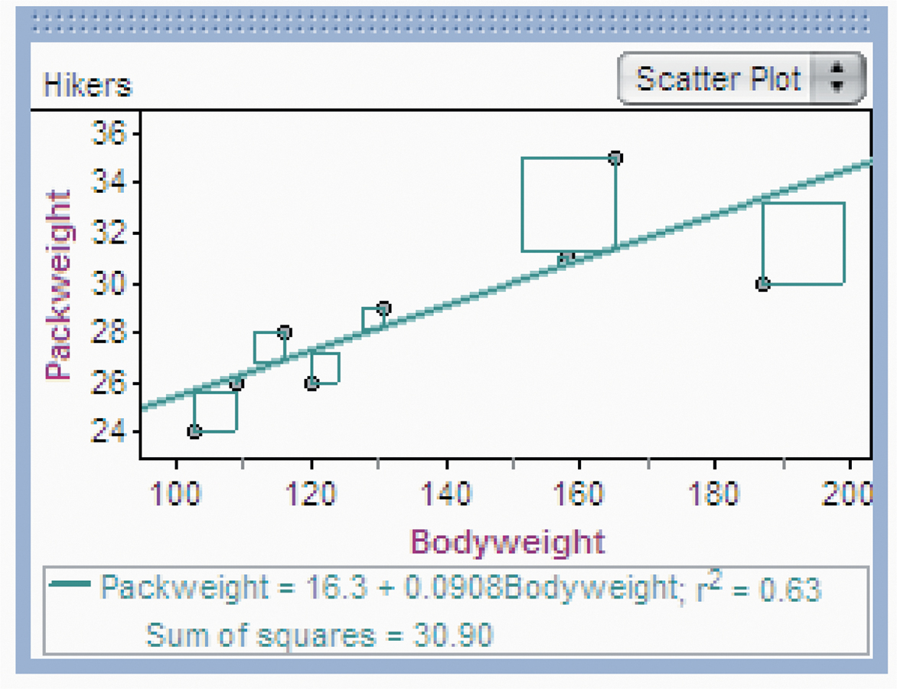
Least-Squares Regression
The Role of r² in Regression
r ² tells us how much better the LSRL does at predicting values of y than simply guessing the mean y for each value in the dataset. Consider the example on page 179. If we needed to predict a backpack weight for a new hiker, but didn’t know each hikers weight, we could use the average backpack weight as our prediction.
SSE/SST = 30.97/83.87
SSE/SST = 0.368
Therefore, 36.8% of the variation in pack weight is unaccounted for by the least-squares regression line.
1 – SSE/SST = 1 – 30.97/83.87
r² = 0.632
63.2 % of the variation in backpack weight is accounted for by the linear model relating pack weight to body weight.
If we use the mean backpack weight as our prediction, the sum of the squared residuals is 83.87.
SST = 83.87
If we use the LSRL to make our predictions, the sum of the squared residuals is 30.90.
SSE = 30.90

Slide 16
Least-Squares Regression
Interpreting Computer Regression Output
A number of statistical software packages produce similar regression output. Be sure you can locate
the slope b,
the y intercept a,
and the values of s and r².

Slide 17
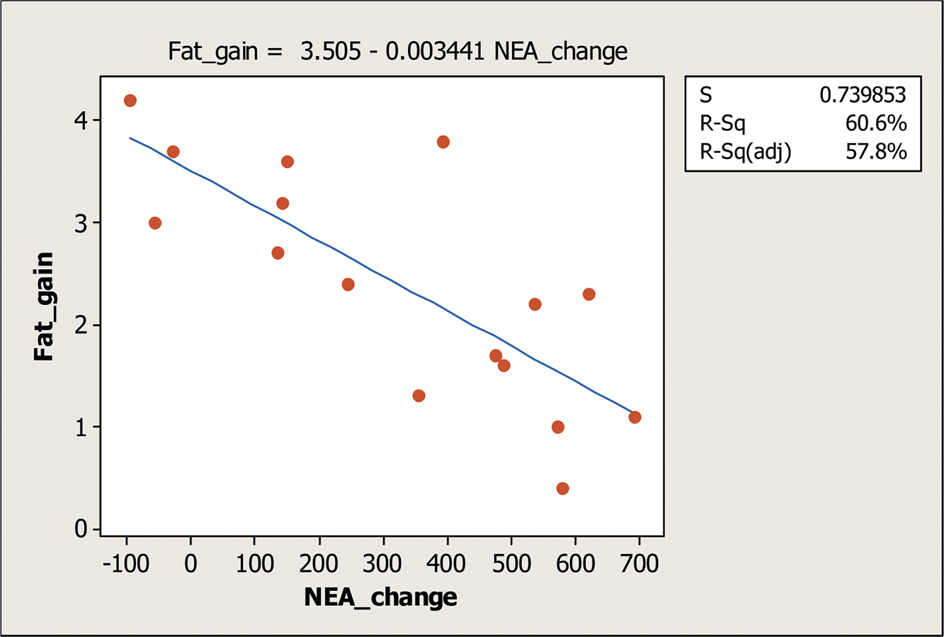
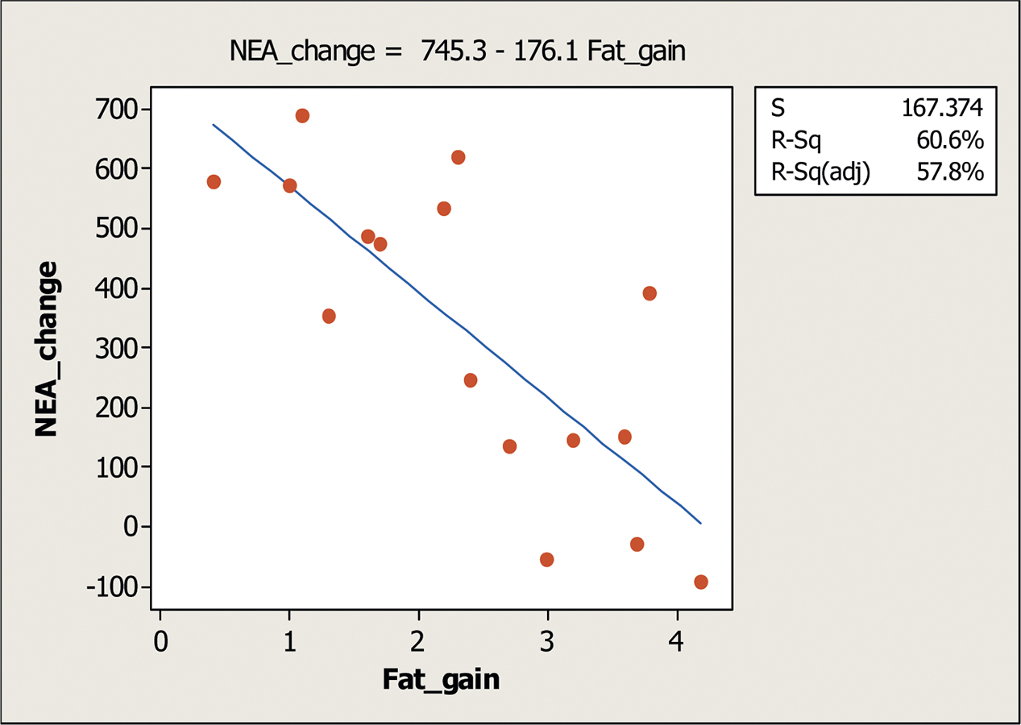
Least-Squares Regression
Correlation and Regression Wisdom
Correlation and regression are powerful tools for describing the relationship between two variables. When you use these tools, be aware of their limitations
1. The distinction between explanatory and response variables is important in regression.

Slide 18
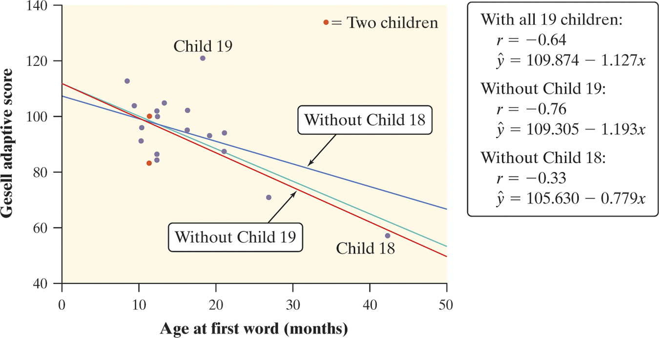
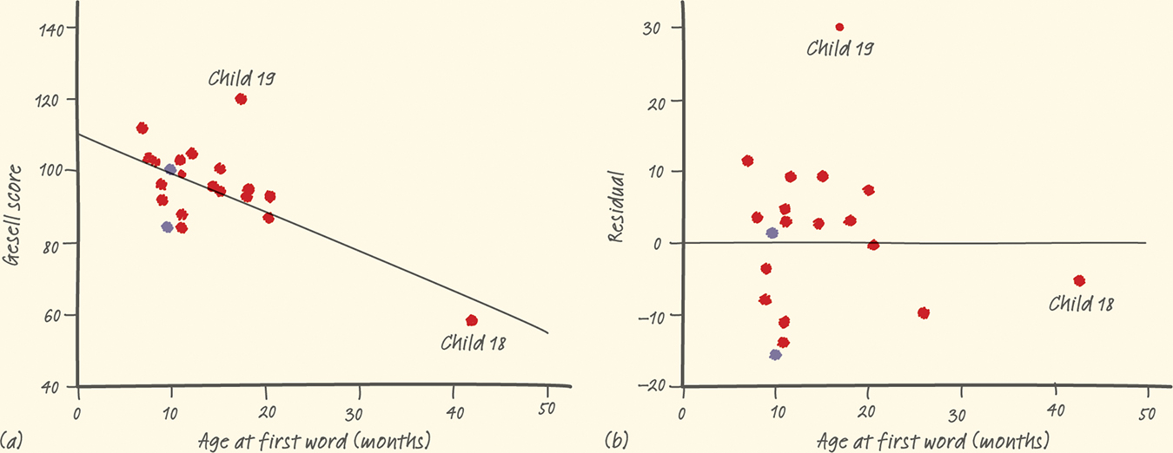
Least-Squares Regression
Correlation and Regression Wisdom
2. Correlation and regression lines describe only linear relationships.
3. Correlation and least-squares regression lines are not resistant.
Definition:
An outlier is an observation that lies outside the overall pattern of the other observations. Points that are outliers in the y direction but not the x direction of a scatterplot have large residuals. Other outliers may not have large residuals.
An observation is influential for a statistical calculation if removing it would markedly change the result of the calculation. Points that are outliers in the x direction of a scatterplot are often influential for the least-squares regression line.

Slide 19
Least-Squares Regression
Correlation and Regression Wisdom
4. Association does not imply causation.
Association Does Not Imply Causation
An association between an explanatory variable x and a response variable y, even if it is very strong, is not by itself good evidence that changes in x actually cause changes in y.
A serious study once found that people with two cars live longer than people who only own one car. Owning three cars is even better, and so on. There is a substantial positive correlation between number of cars x and length of life y. Why?

Slide 20
Section 3.2 Least-Squares Regression
Summary
In this section, we learned that…
A regression line is a straight line that describes how a response variable y changes as an explanatory variable x changes. We can use a regression line to predict the value of y for any value of x.
The slope b of a regression line is the rate at which the predicted response ŷ changes along the line as the explanatory variable x changes. b is the predicted change in y when x increases by 1 unit.
The y intercept a of a regression line is the predicted response for ŷ when the explanatory variable x = 0.
Avoid extrapolation, predicting values outside the range of data from which the line was calculated.

Slide 21
Section 3.2 Least-Squares Regression
Summary
In this section, we learned that…
The least-squares regression line is the straight line ŷ = a + bx that minimizes the sum of the squares of the vertical distances of the observed points from the line.
You can examine the fit of a regression line by studying the residuals (observed y – predicted y). Be on the lookout for points with unusually large residuals and also for nonlinear patterns and uneven variation in the residual plot.
The standard deviation of the residuals s measures the average size of the prediction errors (residuals) when using the regression line.

Slide 22
Section 3.2 Least-Squares Regression
Summary
In this section, we learned that…
The coefficient of determination r² is the fraction of the variation in one variable that is accounted for by least-squares regression on the other variable.
Correlation and regression must be interpreted with caution. Plot the data to be sure the relationship is roughly linear and to detect outliers and influential points.
Be careful not to conclude that there is a cause-and-effect relationship between two variables just because they are strongly associated.

Slide 23
Looking Ahead…
In the next Chapter…
We’ll learn how to properly design studies to produce data.
We’ll learn about
Sampling and Surveys
Experiments
Using Studies Wisely

